Slide 1
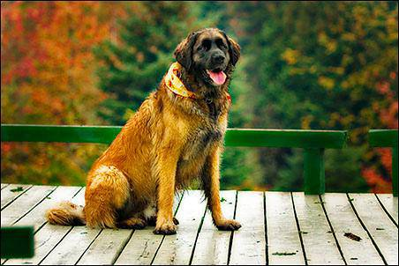
DOG BREED IDENTIFICATION
Presented by,
S.NAVEENPRASATH
613521104021
Notes:
Presented by
S.NAVEENPRASATH
3 rd year CSE

Slide 2
AGENDA
Introduction
Problem statement
Project overview
Proposed solution
Algorithm and development
Result
Conclusion

Slide 3
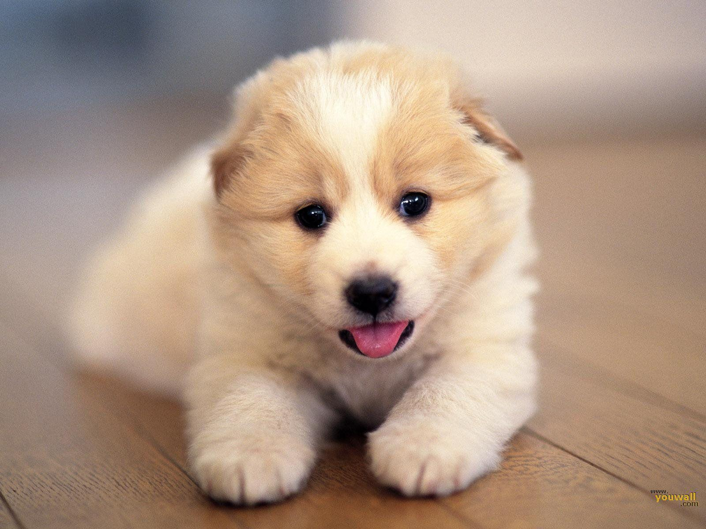
INTRODUCTION
Dog breed identification is a fascinating application of deep learning in computer vision. With the advancement of deep learning models, it has become possible to accurately classify dog breeds based on images. This technology has numerous practical applications, from assisting pet owners in identifying their dog's breed to aiding veterinarians in diagnosing genetic traits.
Dog breed identification is a fascinating application of deep learning, where advanced algorithms are trained to recognize and classify different breeds of dogs based on images. With the rise of deep learning techniques, particularly Convolutional Neural Networks (CNNs), accurate breed identification has become achievable even for a wide variety of dog breeds.

Slide 4

PROBLEM STATEMENT
Key Objectives:
Collect and preprocess a dataset of dog images with labeled breeds.
Design and train a deep learning model capable of classifying dog breeds.
Evaluate the model's performance on a separate test dataset to assess accuracy and generalization.
Fine-tune the model and optimize hyperparameters to improve accuracy if necessary.
Deploy the model for practical use, allowing users to upload images and receive predictions of dog breeds.

Slide 5
PROBLEM STATEMENT
Expected Outcome:
The developed model should achieve a high accuracy rate in identifying dog breeds, demonstrating its effectiveness in real-world scenarios such as pet identification, breed recognition, and related applications.

Slide 6

PROJECT OVERVIEW
Problem Statement: The goal is to develop a deep learning model that can accurately
identify the breed of a dog given an image.
Data Collection: Gather a dataset of dog images with labeled breeds. This dataset should cover a wide range of dog breeds to ensure the model's accuracy across different breeds.
Data Preprocessing: Preprocess the images by resizing them to a uniform size, normalizing pixel values, and possibly augmenting the data to increase diversity and improve generalization.
Model Selection: Choose a deep learning model suitable for image classification tasks. Convolutional Neural Networks (CNNs) are commonly used for this purpose due to their ability to learn hierarchical features from images.

Slide 7
PROJECT OVERVIEW
Model Training: Split the data into training, validation, and test sets. Train the chosen model on the training set and evaluate its performance on the validation set. Fine-tune hyperparameters and model architecture as needed to improve performance.
Evaluation: Evaluate the trained model on the test set to assess its accuracy, precision, recall, and other metrics. Analyze any misclassifications to identify areas for improvement.
Deployment: Once satisfied with the model's performance, deploy it for real-world use. Develop a user-friendly interface where users can upload dog images, and the model predicts the breed.
Continuous Improvement: Gather feedback from users and monitor the model's performance in production. Periodically retrain the model with new data to keep it up-to-date and improve accuracy over time.

Slide 8
PROPOSED SOLUTION
Research: Start by researching popular dog breeds and their characteristics, including size, temperament, exercise needs, grooming requirements, and common health issues.
Visual Learning: Use images or infographics to associate each breed with its distinctive features, such as coat color, ear shape, and body structure.
Classification: Group breeds based on similarities, such as working dogs, toy breeds, herding dogs, etc., to understand broader categories and their unique traits.
Interactive Quizzes: Take online quizzes or use flashcards to test your knowledge and reinforce learning about different breeds.
Hands-On Experience: If possible, visit dog shows, shelters, or breed-specific events to observe breeds in person and interact with them to better understand their behaviors and characteristics.

Slide 9
Algorithm and Development
Data Collection: Gather a large dataset of dog images, labeled with their respective breeds.
Preprocessing: Clean the data, resize images to a consistent size, and normalize pixel values.
Model Selection: Choose a suitable machine learning model such as a convolutional neural network (CNN) for image classification tasks.
Model Training: Train the model using the labeled data, optimizing for accuracy in predicting dog breeds.
Evaluation: Evaluate the model's performance on a separate test set to assess its accuracy and generalization ability.
Deployment: Once satisfied with the model's performance, deploy it to classify dog breeds in new images.

Slide 10
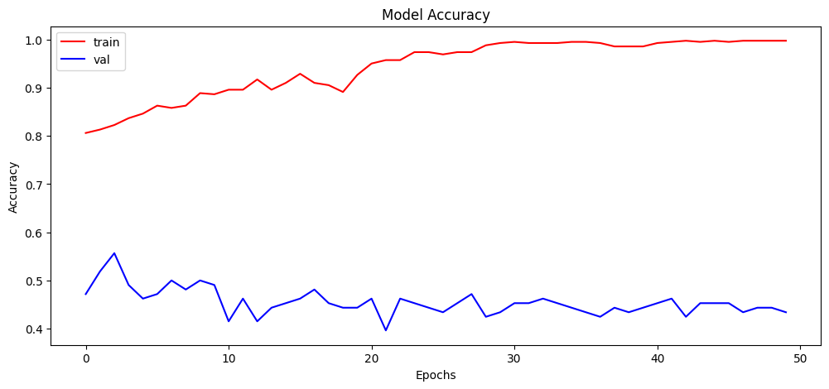
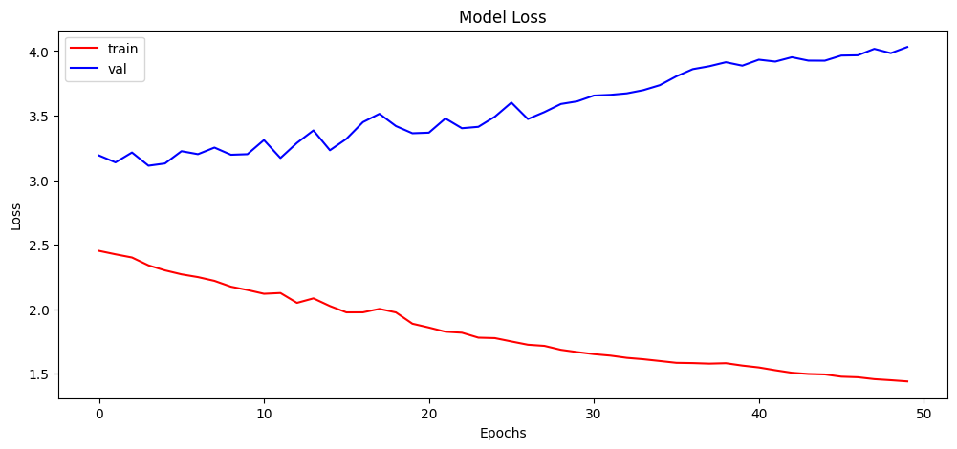
RESULT

Slide 11
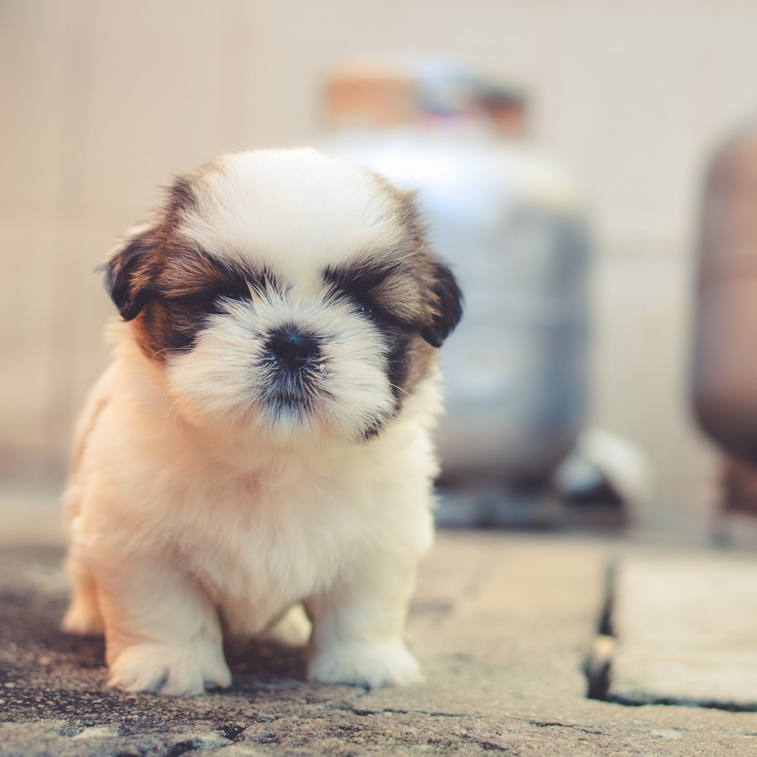
CONCLUSION
Summarize the key takeaways from the project, emphasizing the successful implementation of deep learning for dog breed classification, the achieved performance metrics, and the potential impact of the project in real-world applications.

